Slide 1
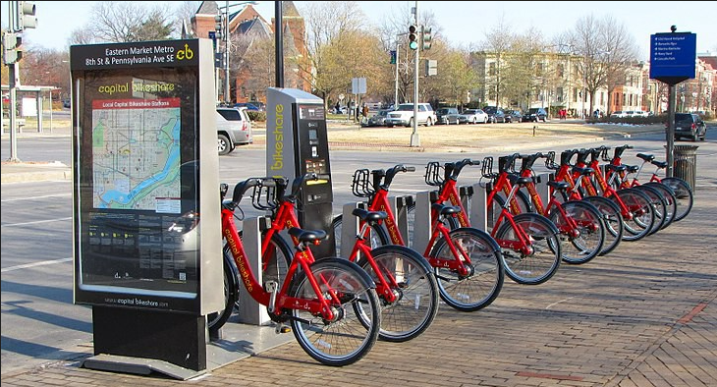
Bike Sharing Demand Prediction (Supervised Machine Learning regression ) By Manas Nayan Mukherjee & Kunal Rameshrao Kodarlikar
Capstone Project -2

Slide 2
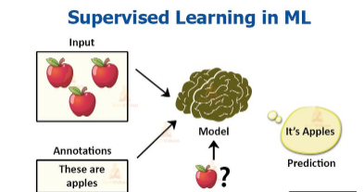
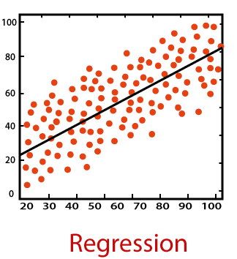
Supervised Learning and Regression
What is Supervised learning: It is the machine learning task of learning a function that maps an input to an output based on example input-output pairs. It infers a function from labeled training data consisting of a set of training examples. A supervised learning algorithm analyzes the training data and produces an inferred function, which can be used for mapping new examples. An optimal scenario will allow for the algorithm to correctly determine the class labels for unseen instances.
Relevance: Supervised machine learning turns data into real, actionable insights. It enables organizations to use data to understand and prevent unwanted outcomes or boost desired outcomes for their target variable.
What is Regression: A regression is a statistical technique that relates a dependent variable to one or more independent (explanatory) variables. Regression models are used to predict a continuous value. Predicting prices of a house given the features of house like size, price etc is one of the common examples of Regression.
Relevance: It helps an organisation to understand what their data points represent and use them accordingly with the help of business analytical techniques in order to do better decision-making.

Slide 3
 Problem Statement
It is important to make the rental bike available and accessible to the public at the right time as it lessens the waiting time. Eventually, providing the city with a stable supply of rental bikes becomes a major concern.
Currently Rental bikes are introduced in many urban cities for the enhancement of mobility comfort. The client is Seoul Bike, which participates in a bike share program in Seoul, South Korea. An accurate prediction of bike count is critical to the success of the Seoul bike share program.
The final aim of this project is the prediction of bike count required at each hour for the stable supply of rental bikes.

Slide 4
 Work flow segregation
Data collection
and
Understanding
Data Wrangling
and
Feature Engineering
Exploratory Data Analysis
Conclusion
Model Selection and Evaluation
Preparation of data for model building

Slide 5
 Data collection and understanding
We had a Seoul Bike Data for our analysis and model building.The dataset contains weather information (such as Temperature, Humidity, Wind speed, Visibility, Dew point, Solar radiation, Snowfall, Rainfall), the number of bikes rented per hour and date information. In this we had total 8761 observations and 14 features including target variable.
Data Description:
Date : year-month-day.
Hour : Hour of the day.
Temperature : Temperature in Celsius.
Humidity : %. Wind speed - m/s. Visibility - m.
Dew point temperature : Celsius.
Solar radiation : MJ (Mega Jule)/m2.
Rainfall : mm.
Snowfall : cm.
Seasons : Winter, Spring, Summer, Autumn.
Holiday : Holiday/No holiday.
Functional Day : NoFunc(Non Functional Hours), Fun(Functional hours).
Rented Bike count : Count of bikes rented at each hour (Target Variable i.e Y variable).

Slide 6
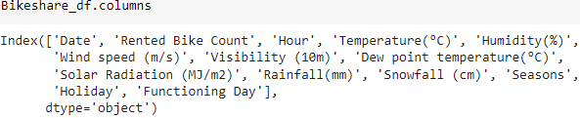
 Data Wrangling and Feature engineering
We have a data set with 8761 observations and 14 features.
Categorical Features: Seasons, Holiday and Functioning day.
Numerical Columns: Date, Hour, Temperature, Humidity, Wind speed, Visibility, Dew point temperature, Solar radiation, Rainfall, Snowfall, Rented Bike count .
Rename Columns: We renamed the columns because they had units mentioned in brackets and was difficult to copy the feature name while working.

Slide 7

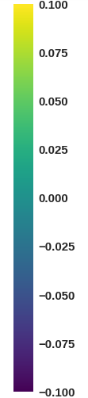
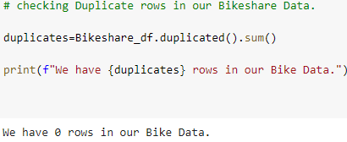
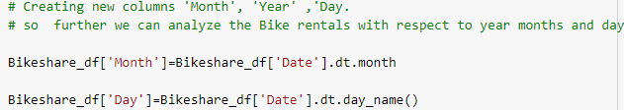
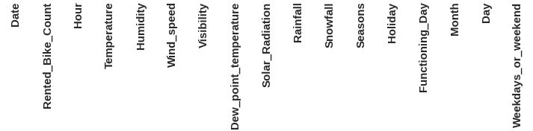
 Data Wrangling and Feature engineering
We had zero null values in our dataset.
Zero Duplicate entries found.
We changed the data type of Date column from ‘object’ to ‘datetime64[ns]’. This was done for feature engineering.
We Created two new columns with the help of Date column ‘Month’ and ‘Day’. Which were further used for EDA. And later we dropped Date column.

Slide 8
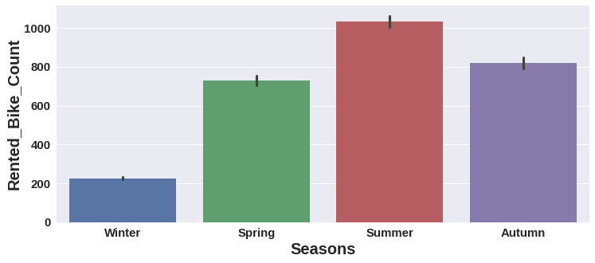
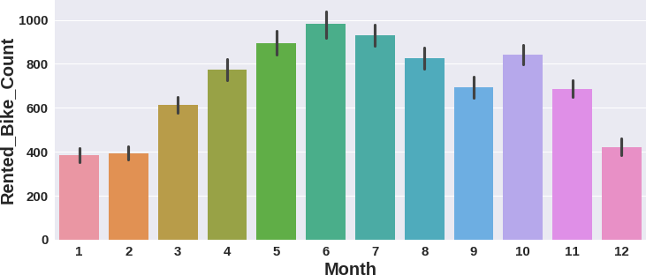
 Exploratory Data Analysis (EDA)
Observations
Relation of rented bike count with categorical features:
Summer season had the highest Bike Rent Count. People are more likely to take rented bikes in summer. Bike rentals in winter is very less compared to other seasons.
From March Bike Rent Count started increasing and it was highest in June.

Slide 9
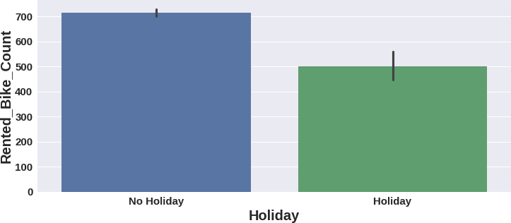
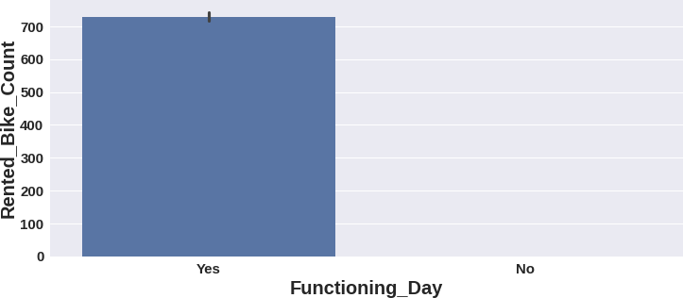
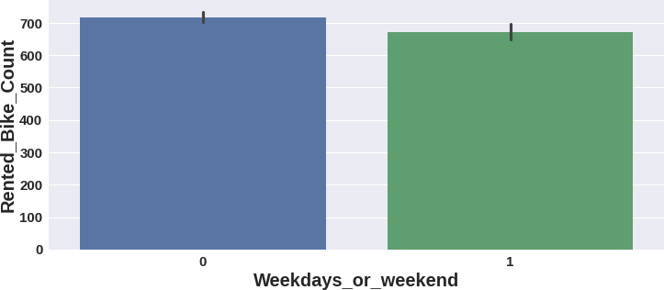
 Exploratory Data Analysis (EDA)
Observations
High number of bikes were rented on No Holidays. Which is almost 700 bikes.
Zero Bikes were rented on no functioning day. More than 700 bikes rented on functioning day.
More than 700 bikes were rented on weekdays. On weekdays, almost 650 bikes were rented.

Slide 10
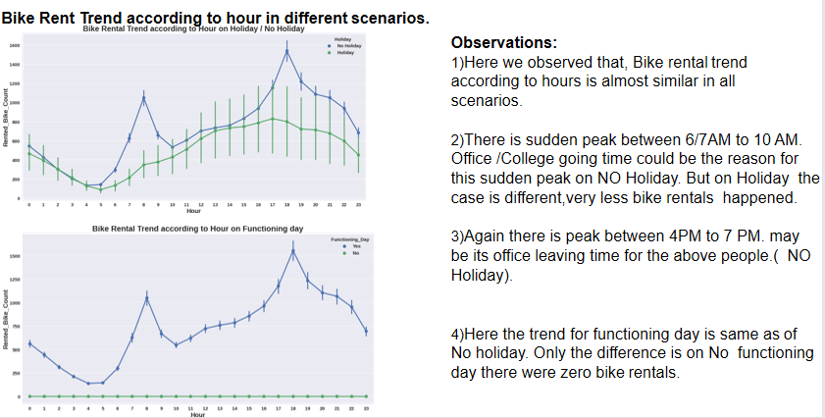
 Exploratory Data Analysis (EDA)

Slide 11
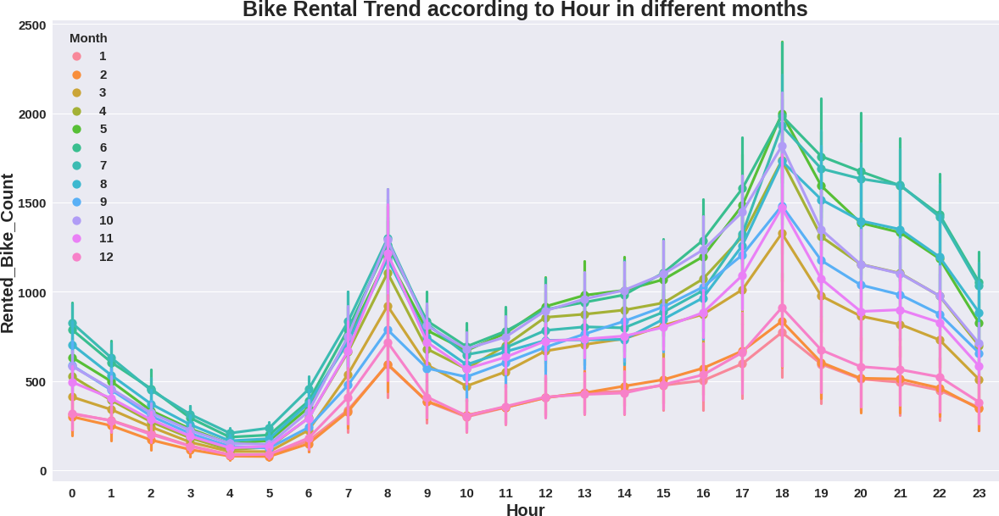
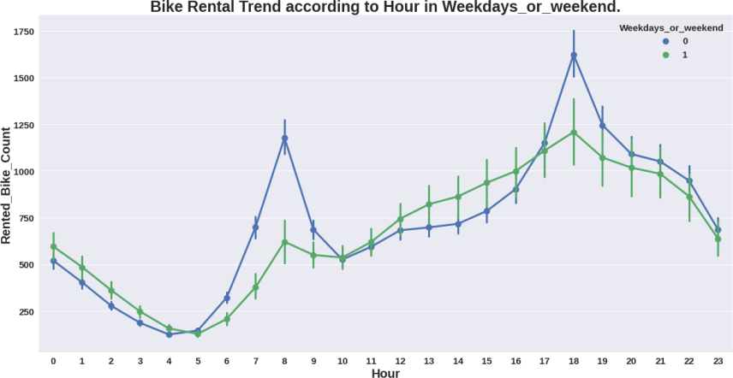
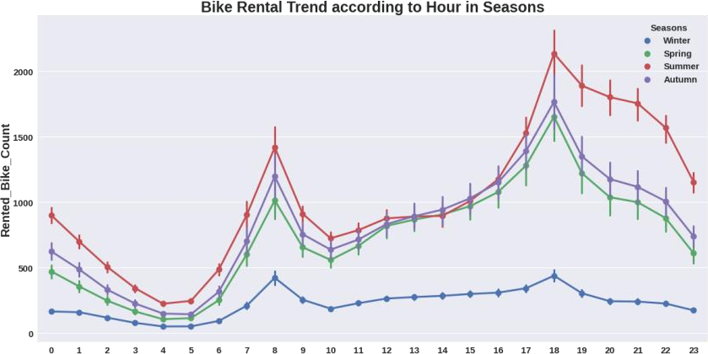
 Exploratory Data Analysis (EDA)
Bike Rent Trend according to hour in different scenarios.

Slide 12
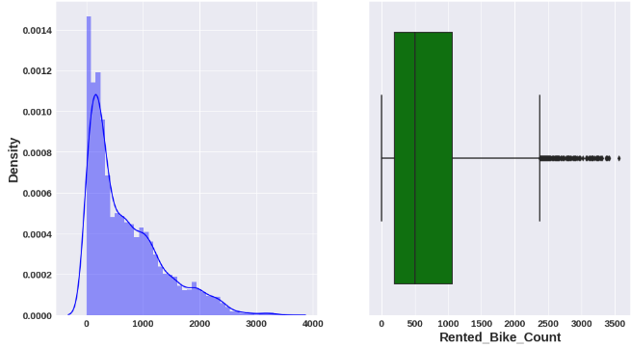
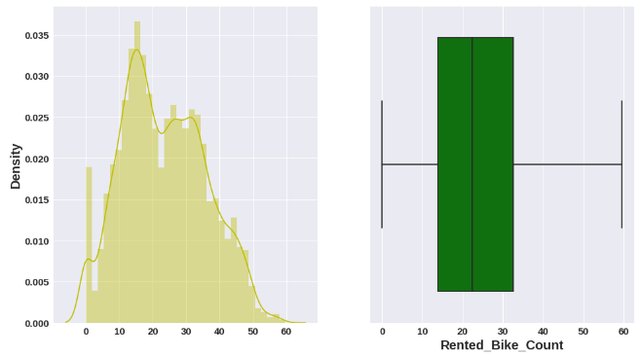
 Exploratory Data Analysis (EDA)
Distribution of target variable- Bike Rent Count
Distribution is rightly skewed and some outliers are observed.
To normalize the distribution we applied square root method. After normalization no outliers were found.

Slide 13
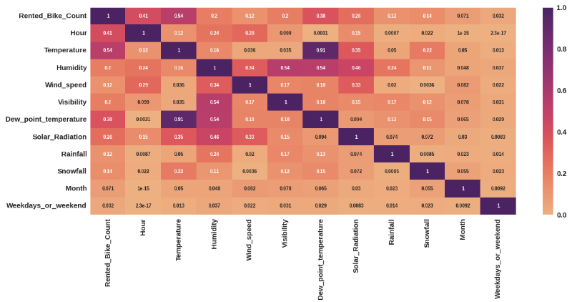
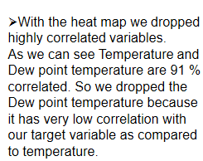
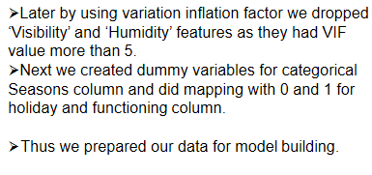
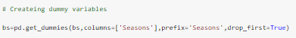
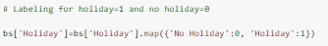
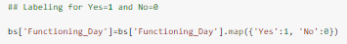
 Preparation of data for model building

Slide 14
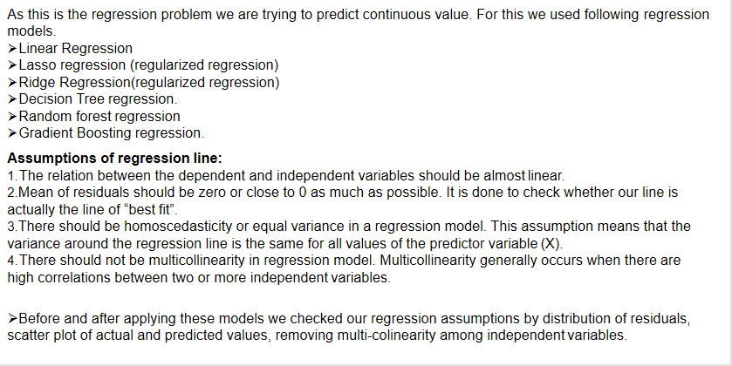
 Model selection and evaluation

Slide 15
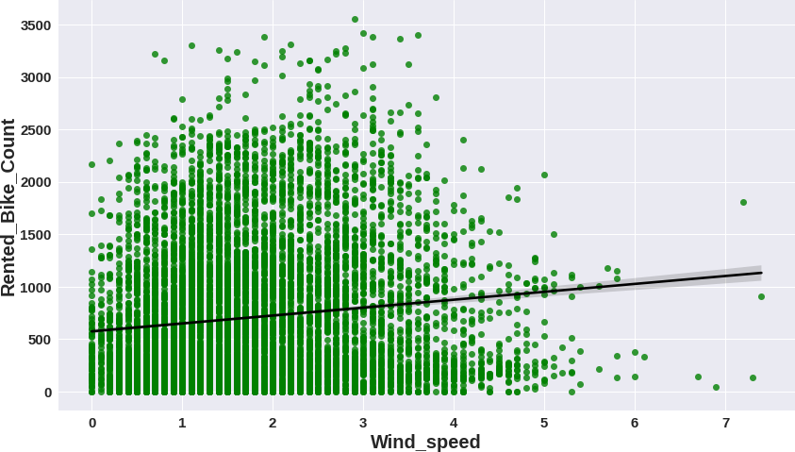
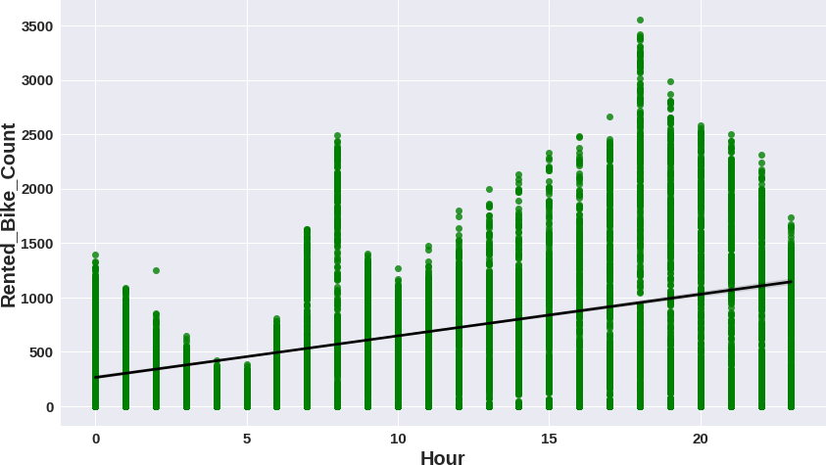
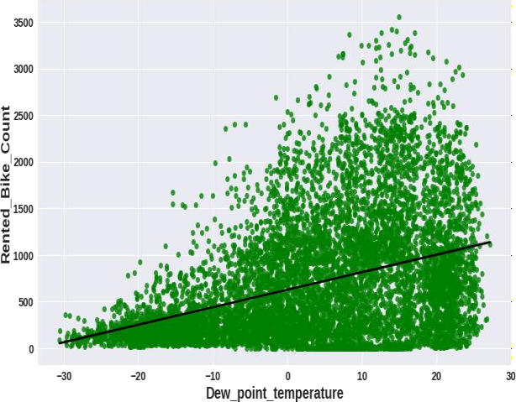
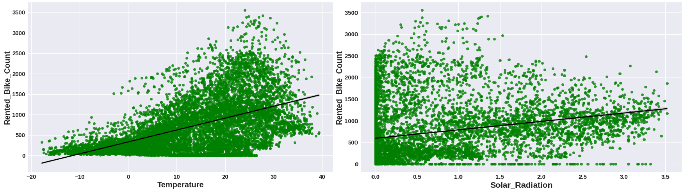
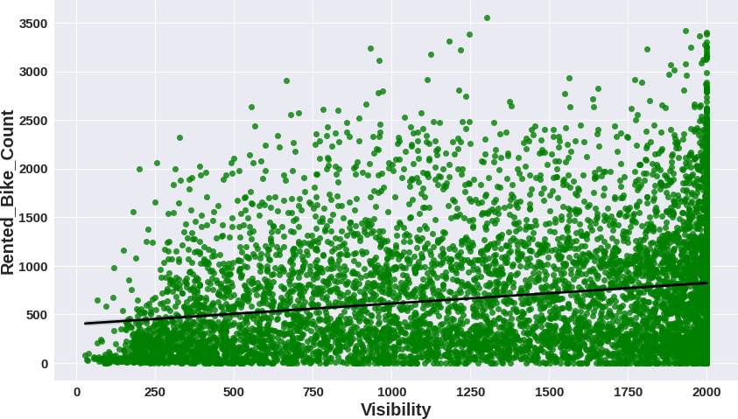
 Model selection and evaluation
From the above regression plot of all numerical features we see that the columns 'Temperature', 'Wind_speed', 'Visibility', 'Dew_point_temperature', 'Solar_Radiation' are positively related to the target variable,which means the rented bike count increases with increase of these features.

Slide 16
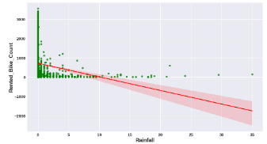
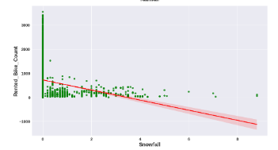
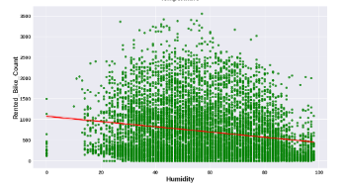
 Model selection and evaluation
'Rainfall',‘ Snowfall’, 'Humidity' these features are negatively related with the target variable which means the rented bike count decreases when these features increases.

Slide 17
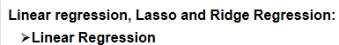
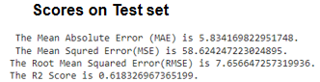
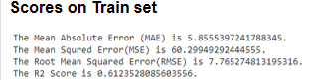
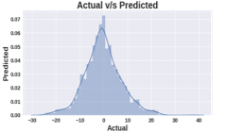
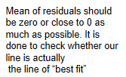
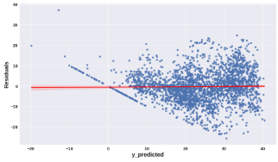
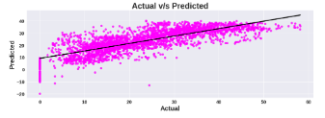
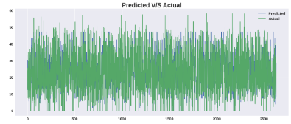
 Model selection and evaluation

Slide 18
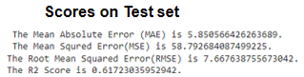
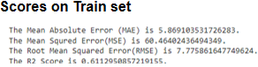
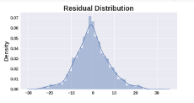
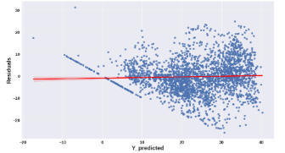
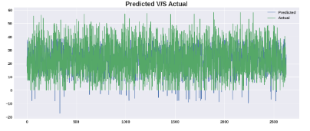
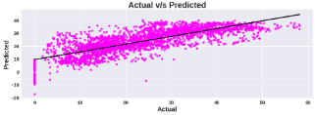
 Model selection and evaluation

Slide 19
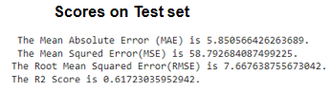
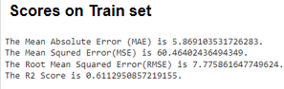




 Model selection and evaluation

Slide 20






 Model selection and evaluation

Slide 21







 Model selection and evaluation

Slide 22






 Model selection and evaluation

Slide 23







 Model selection and evaluation
Gradient boosting regression(Hyper-parameter tuned- 'learning_rate': 0.04, 'max_depth': 8, 'n_estimators': 150, 'subsample': 0.9)

Slide 24



 Feature importances
From all the 3 models we can say that temperature, hour, functioning day are the top 3 important features.

Slide 25


 Conclusion

Slide 26


 Conclusion
Thus Gradient Boosting Regression(GridSearchCV)
and
Random forest(GridSearchCv) gives good r2 scores.
We can deploy these models.

Slide 27


